Slide 1
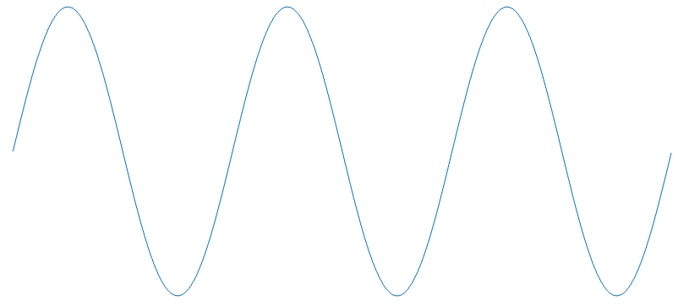




ϴ₁(t)
x₁(t)
t
$$f_{θ}(θ)$$
ϴ₂(t)
$$\frac{1}{\text{2}π }$$
$$θ$$
x₂(t)
t
2$π$
ϴ₃(t)
x₃(t)
t

Slide 3
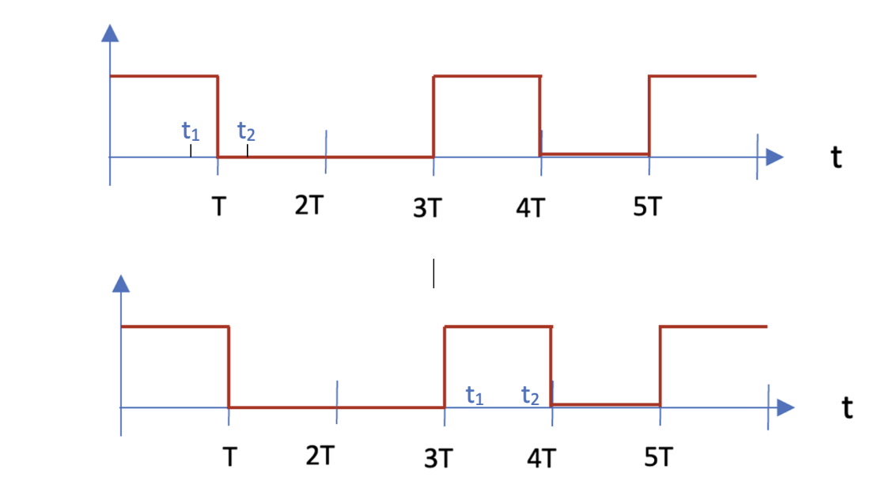





1
0
1
0
$$f_{Y}(y)$$
1
$$x_{2}(t)$$
0
$$t$$
T
2T
3T
4T
5T
1
$$x_{1}(t)$$
0
$$t$$
T
2T
3T
4T
5T

Slide 4




1
0
1
0
$$f_{Y}(y)$$
1
$$x_{2}(t)$$
$$t_{1}$$
0
$$t_{2}$$
$$t$$
T
2T
3T
4T
5T
1
$$x_{1}(t)$$
0
$$t_{1}$$
$$t_{2}$$
$$t$$
T
2T
3T
4T
5T

Slide 5


1
0
1
0
$$f_{Y}(y)$$
1
$$x_{2}(t)$$
$$t$$
-1
T
2T
3T
4T
5T
1
$$x_{1}(t)$$
$$t$$
-1
T
2T
3T
4T
5T

Slide 6
1
0
1
0

Slide 7
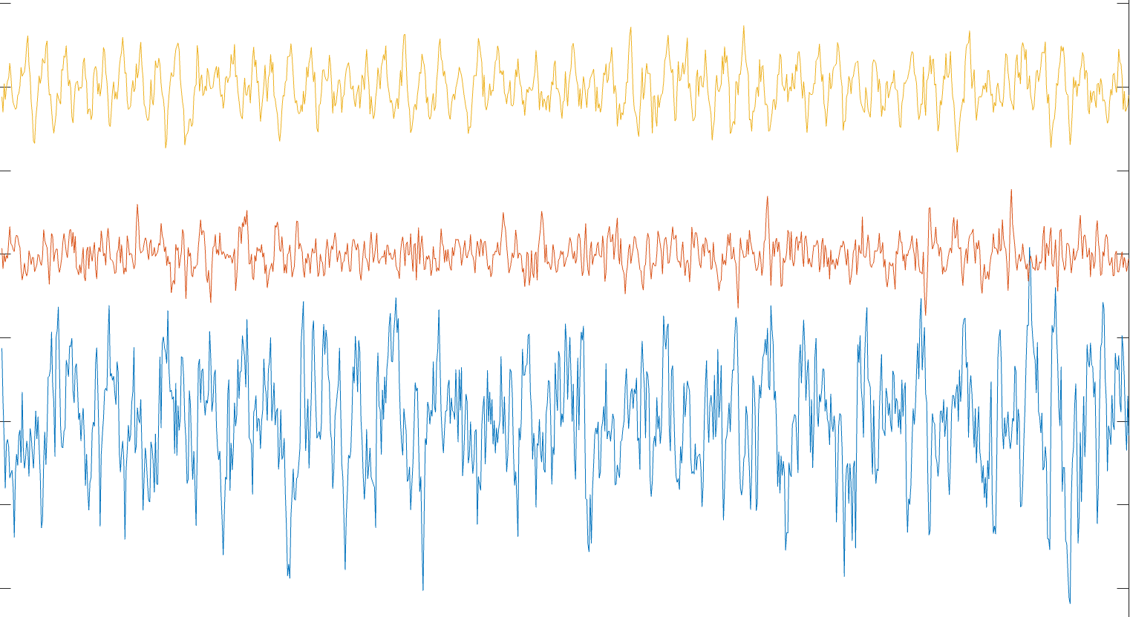
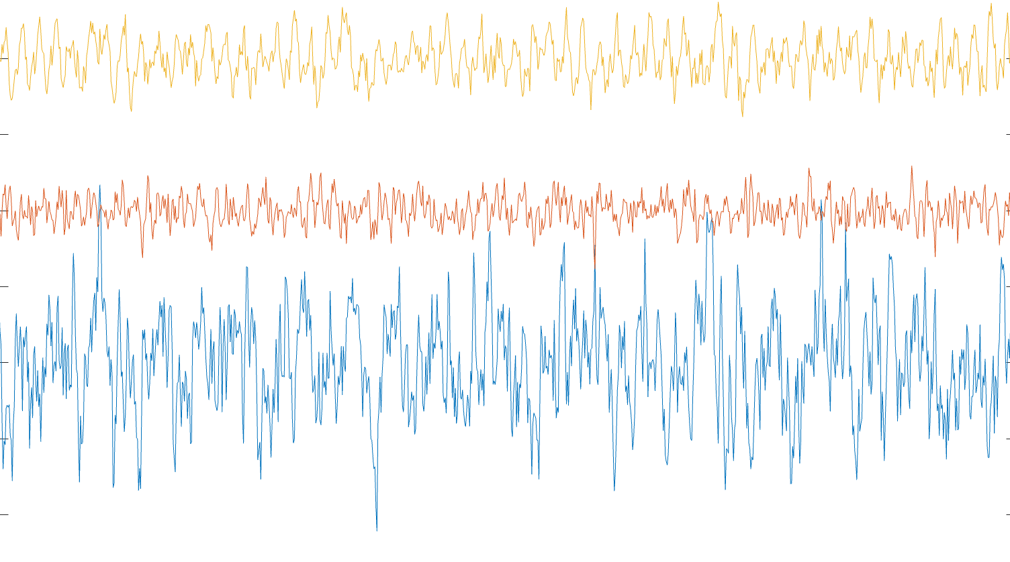
X(t)
Y(t)
X(t₁)
Y(t₂)

Slide 8
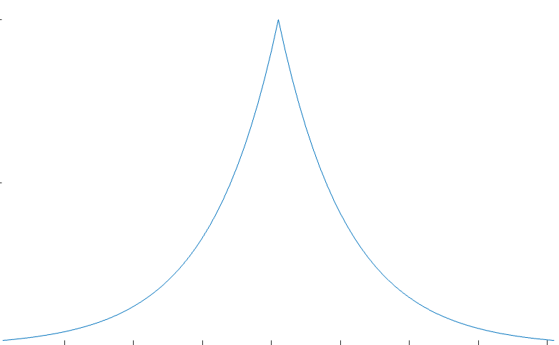

Slide 9
X(t)
Y(t)

Slide 10
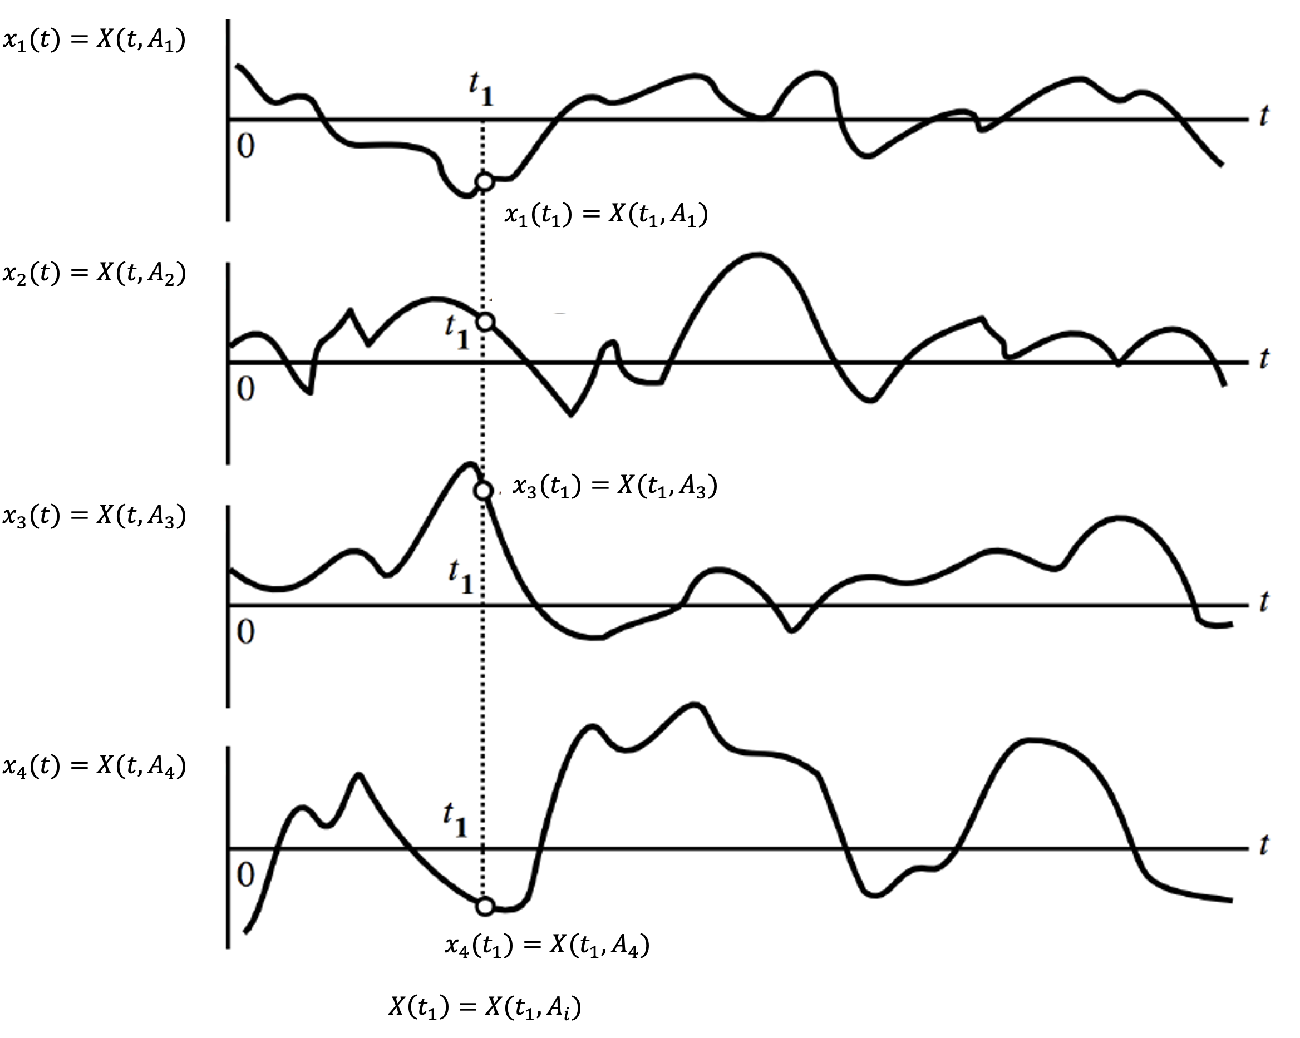



$$T$$
$$μ_{X}\left(t_{1}\right)=E[X\left(t_{1}\right)]$$

Slide 11
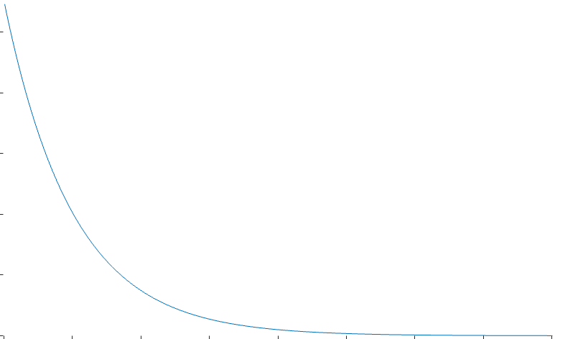
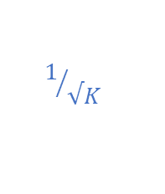
h(t)
$$1/{√K}$$
t

Slide 12
Imaginary
jω domain
Real

Slide 13
Imaginary
+ja (+ve time)
Real
-ja (-ve time)

Slide 14




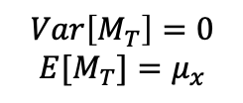


M_{T}
X₁(t)
as $T→∞$
$$μ_{x}$$
$$Var\left[M_{T}\right]=0$$
$$E[M_{T}]=μ_{x}$$
X₂(t)
$$Var\left[{M_{T}}_{1}\right]≠0$$
T
T₁

Slide 15
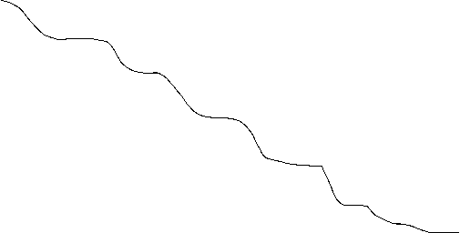
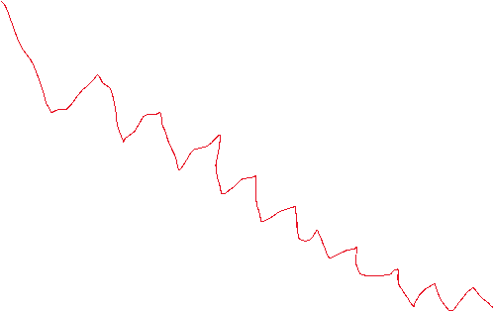



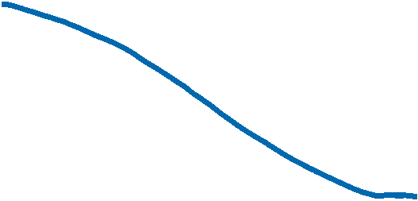

R_{T}(𝛕)
$${R_{T}}_{1}\left(τ\right)$$
$$T_{2}>T_{1}$$
$${R_{T}}_{2}\left(τ\right)$$
$$φ_{XX}(τ)$$
𝛕

Slide 16




$$φ_{XX}\left(τ\right)$$
$\frac{a^{2}}{2}$=MSV
$$τ$$
$$\frac{2π}{ω_{0}}$$

Slide 17
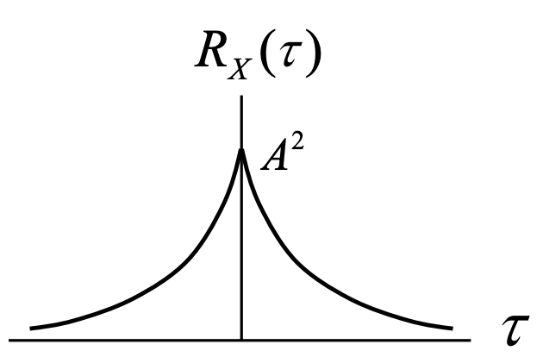


$$φ_{XX}\left(τ\right)$$
i ͢
X(t)
$$1$$
R

Slide 18
1
-T
T
τ

Slide 19
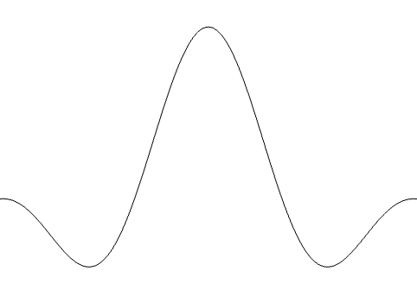



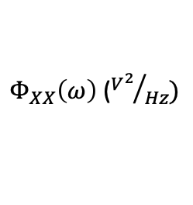






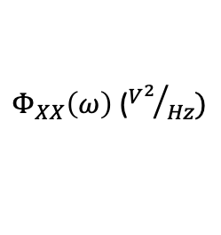







$Φ_{XX}\left(ω\right)$ (${V^{2}}/{Hz})$
$$φ_{XX}\left(τ\right){ (V}^{2})$$
$$K$$
$$K$$
$$−∞←$$
$$→∞$$
$$f$$
$$τ$$
$$0$$
$$0$$
$Φ_{XX}\left(ω\right)$ (${V^{2}}/{Hz})$
$$φ_{XX}\left(τ\right){ (V}^{2})$$
$$2BK$$
$$K$$
$$f$$
$$τ$$
$$−B$$
$$0$$
$$B$$
$$0$$
$$τ_{0}= \frac{1}{2B}$$

Slide 20
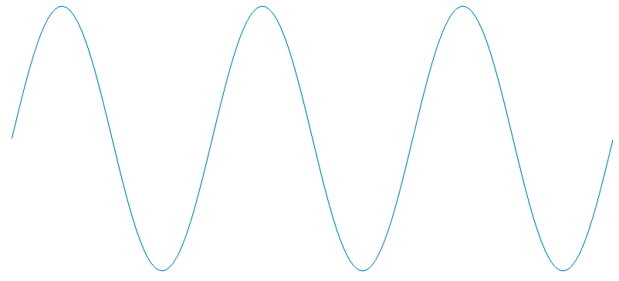



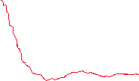
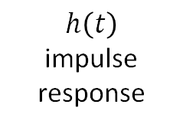


$$φ_{XX}\left(τ\right)$$
$$\frac{A^{2}}{2}cos⁡(ωτ)$$
$$τ$$
$$h\left(t\right)$$
impulse response
$$X(t)$$
$$Y(t)$$

Slide 21













$$X$$
$$D$$
$$C$$
$$Y$$
$$X$$
$$D$$
$$C$$
$$Y$$
$$X$$
$$C$$
$$Y$$
$$X$$
$$C$$
$$Y$$
$${FP}_{c}$$
$${FP}_{d}$$
$$H0$$
$$H1$$
$${FN}_{c}$$
$${FN}_{d}$$

Slide 22
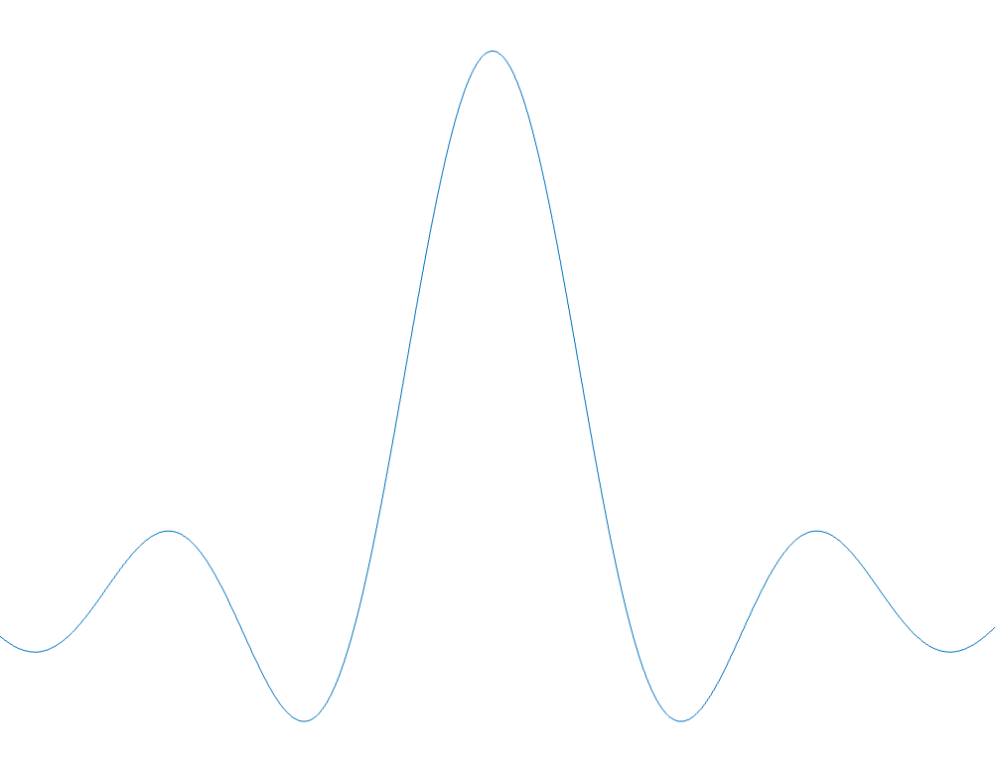



$$φ_{XX}\left(τ\right)$$
$$MSV=σ_{X}^{2}+μ_{X}^{2}$$
$$μ_{X}^{2}$$
$$τ$$

Slide 23










































$$f_{y}(y)$$
$$f_{y}(y)$$
$$0.8$$
$$0.5$$
$$0.2$$
$$0.2$$
$$0.2$$
$$0.1$$
$$y$$
$$y$$
$$−1$$
$$0$$
$$1$$
$$0$$
$$1$$
$$2$$
$$3$$
$$4$$
$$(a)$$
$$(b)$$
Direct substitution
$$f_{y}(y)$$
$$f_{y}(y)$$
$$0.8$$
$$0.5$$
$$0.2$$
$0.2$/A
$0.2$/A
$$0.05$$
$0.1$/A
$$y$$
$$y$$
$$−1$$
$$0$$
$$1$$
$$−2A$$
$$−A$$
$$0$$
$$A$$
$2$A
$$3A$$
$$4A$$
$$(c)$$
$$(d)$$

Slide 24















$$f_{y}(y)$$
$$f_{y}(y)$$
$$0.8$$
$$0.5$$
$$0.2$$
$$0.1$$
$$0.15$$
$$0.0125$$
$$0.0875$$
$$0.1$$
$$0.05$$
$$y$$
$$y$$
$$−1$$
$$0$$
$$1$$
$$−2$$
$$−1$$
$$0$$
$$1$$
$$2$$
$$3$$
$$4$$
$$(a)$$
$$(e)$$
Direct substitution
$$f_{y}(y)$$
$$f_{y}(y)$$
$$0.8$$
$$0.5$$
$$0.2$$
$0.2$/A
$0.2$/A
$$0.05$$
$0.1$/A
$$y$$
$$y$$
$$−1$$
$$0$$
$$1$$
$$−2A$$
$$−A$$
$$0$$
$$A$$
$2$A
$$3A$$
$$4A$$
$$(c)$$
$$(d)$$

Slide 25









$$f_{Y}(y)$$
$$F_{Y}(y)$$
$$\frac{1}{5}$$
$$\frac{1}{5}$$
$$1$$
$$\frac{1}{20}$$
$$\frac{4}{5}$$
$$20$$
$$1$$
$$\frac{1}{5}$$
$$y$$
$$y$$
-6
6
-6
6

Slide 26
$$φ_{XX}\left(τ\right)$$

Slide 28




x$(t)$
y$\left(t\right)= \hat{z(t)}$
z$(t)$
LTI system
+
e$(t)$

Slide 29
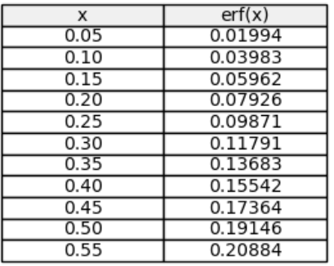
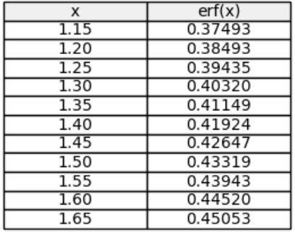
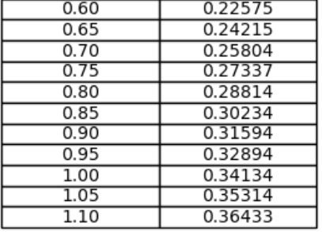
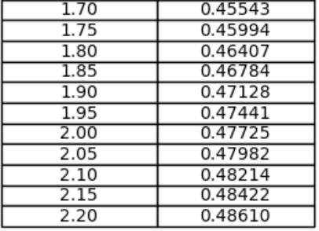

Slide 30






y$\left(t\right)= \hat{z(t)}$
z$(t)$
+
e$(t)$
Narrow-band filter (f, B_{e})
$$\int_{0}^{T}{dt}$$
x$(t)$
squarer
$\hat{MSV}$(f, B_{e})
$$Φ_{xx}\left(f\right)$$
B_{e}
B_{e}
f
f
f
f

Slide 31

$$Φ_{xx}\left(f\right)$$
B_{e1}
B_{e2}
f
f
B_{e}

